Slide 1
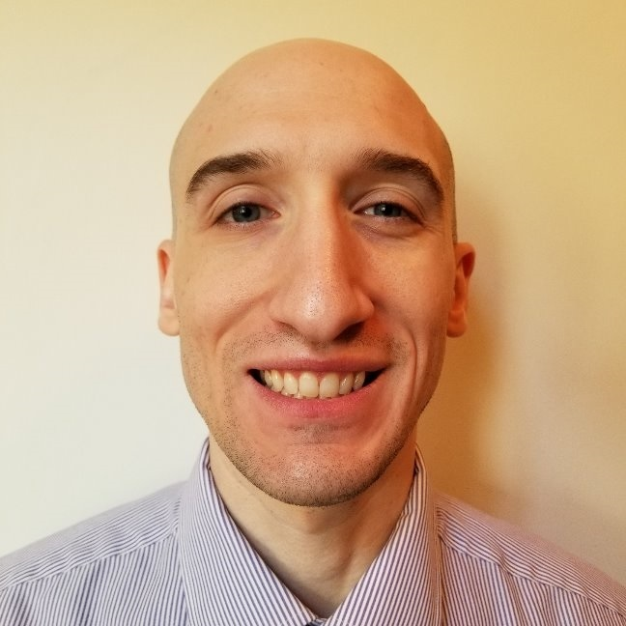









https://www.isaaclevin.com
@isaacrlevin
https://www.coffeeandopensource.com
@isaacrlevin
@isaacrlevin@fosstodon.org

